Slide 1
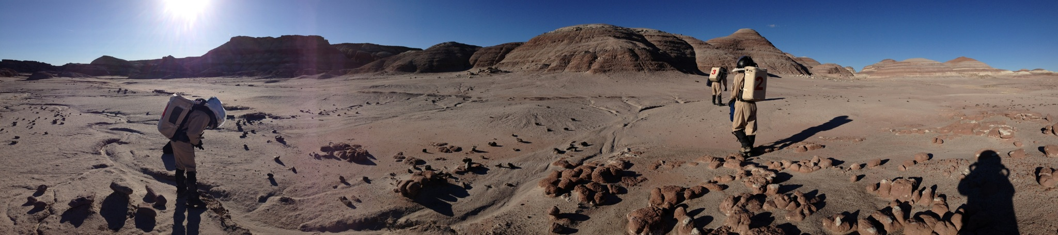
DIGITAL EVA TRACKING FOR MDRS
DESIGN BY KENT NEBERGALL, ERIC KRISTOFF, AND JASON SIMPSON
PRESENTED BY JASON SIMPSON

Slide 2

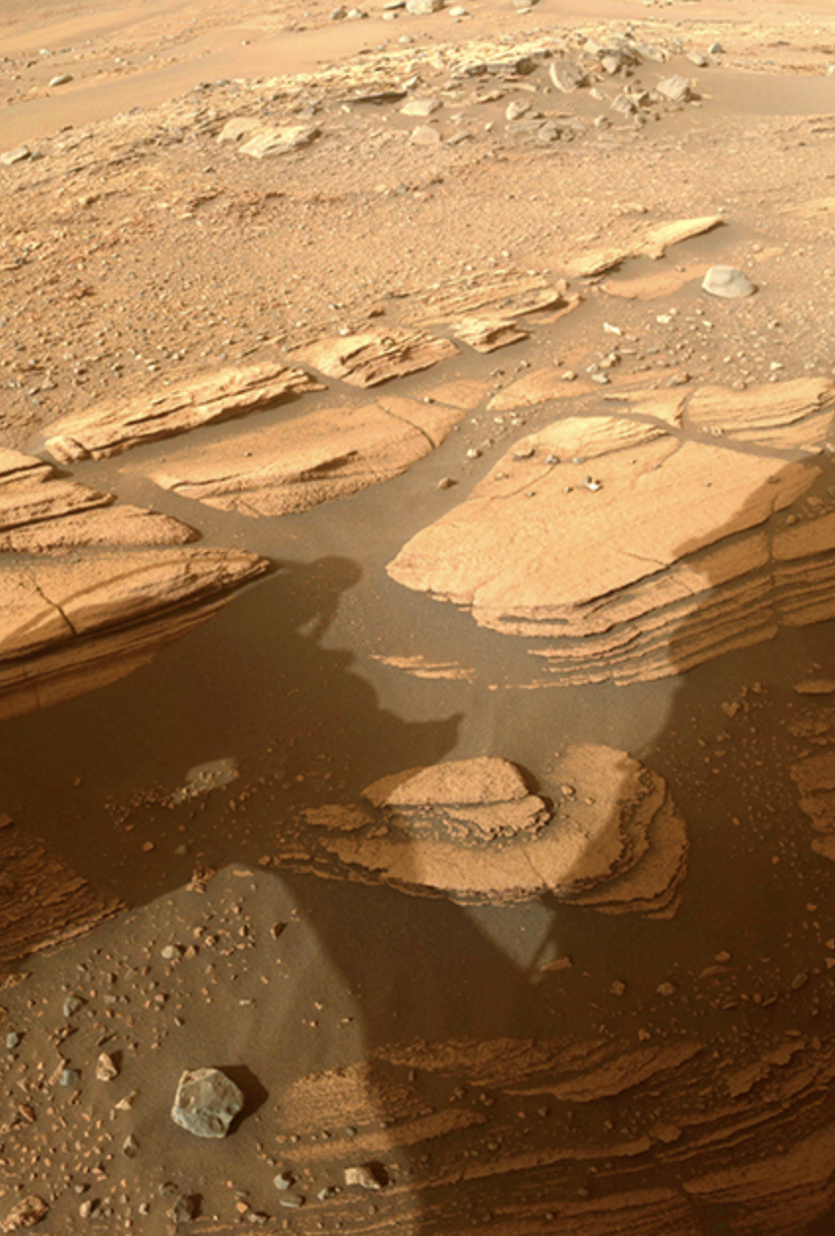

MISSION
Develop a prototype mesh network using open-source software and low-cost hardware to support human and device communications for analog research stations.
Notes:
Not in search of a solution without a problem, we see this as an opportunity to improve the digital data capture between the field and the habitat, providing for automatic, real-time sample logging, telemetry, and location tagging enabling researchers to publish using verifiable data

Slide 3
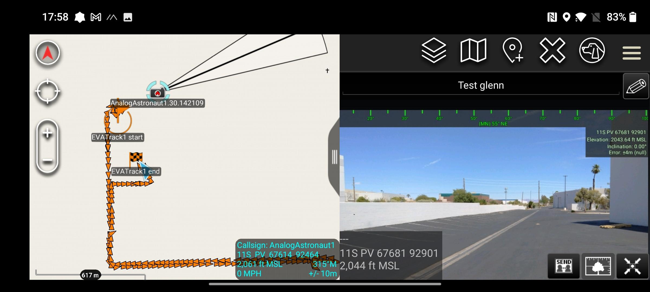
PRIMARY GOALS
GPS tracking of suits, ATVs, and supported equipment relayed to Hab periodically.
Track geology sample positions in a permanent MDRS database (Science)
Immersion in EVA/Mars experience (Sim)
Log EVA paths and compare planned/actual paths (Mission Planning)
Identify interesting locations for revisit/research
Notes:
We aim to get feedback on the idea and for volunteers to get involved with the project.

Slide 4
ROAD MAP
Core
Mesh Network
GIS System
Lab Notebook
Enhance
Digital Voice
Solar hilltop relays
High Bandwidth
API
Field Gear
Weather Stations
Sensors
2.0
Suit Temp & Movement Data
Follow Me Drones
Internet Messaging/Remote Observers
Notes:
Base System
Mesh network using off the shelf, open source software and smartphone links. - Communicate and track EVA across 5-15 km
GIS system for logging routes, samples, and crew messaging - Promotes safety, simulation immersion and science dramatically.
Lab notebook for reporting samples upon return to MDRS Science Dome - Gives continuity logs across crews and filtered research on topics.
Full System
Add a secondary digital voice system, improved logging, and solar-powered hilltop relays. - Secondary digital voice system across medium range.
Open API
Give a common API for interfacing field gear with the system, allowing motion studies, free-standing weather stations, photo tagging, smart-suit add-ons, and other capabilities. - Allows future crews, volunteers and university teams to expand the sensor and science network.
Allow data mining of the research database. - Add AI analysis, crowd-exploration, and other democratization efforts
2.0
Suit temperature/movement data, follow-me drones, voice transcription and SMS to remote researchers.

Slide 5



MESHNET TECH STACK
LoRa
Meshtastic
CIV-TAK
Notes:
LORA - Low Power, Wide Area (LPWA) networking protocol designed to wirelessly connect battery operated devices to the internet in regional, national or global networks, and targets key Internet of things (IoT) requirements such as bi-directional communication, end-to-end security, mobility and localization services.
Meshatstic - An open source, off-grid, decentralized, mesh network built to run on affordable, low-power devices
Android Team Awareness Kit (ATAK) – Created by AFRL based on NASA WorldWind Mobile Codebase is an Android smartphone geospatial infrastructure and situation awareness app. It allows for precision targeting, surrounding land formation intelligence, situational awareness, navigation, and data sharing.] ATAK has a plugin architecture which allows developers to add functionality.

Slide 6

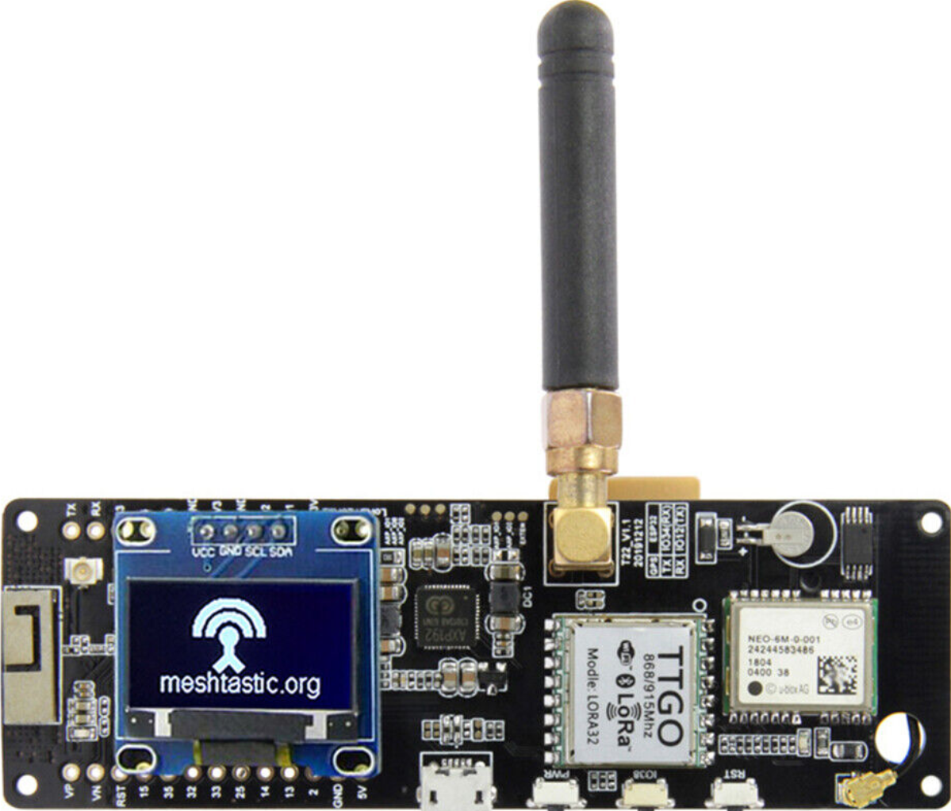
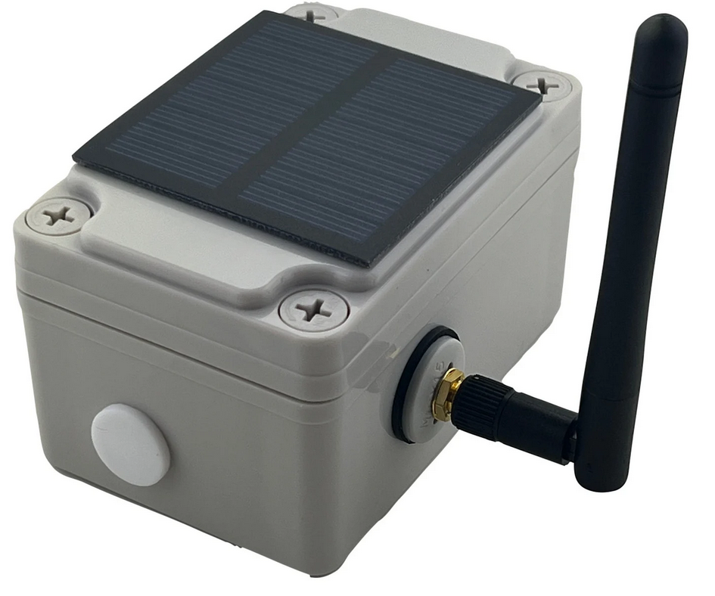
LORA HARDWARE TTGO T-BEAM
Low Cost - $45
Rugged, -40℃- +85℃
Low Power, Solar Capable
ESP32 - Wifi & Bluetooth
SX1276 - LoRa Transceiver
Frequency options:
433 MHz
868 MHz
915 MHz
923 MHz
NEO-6M - GPS receiver
SMA antenna connector
0.96 inch OLED display (soldering required)

Slide 7
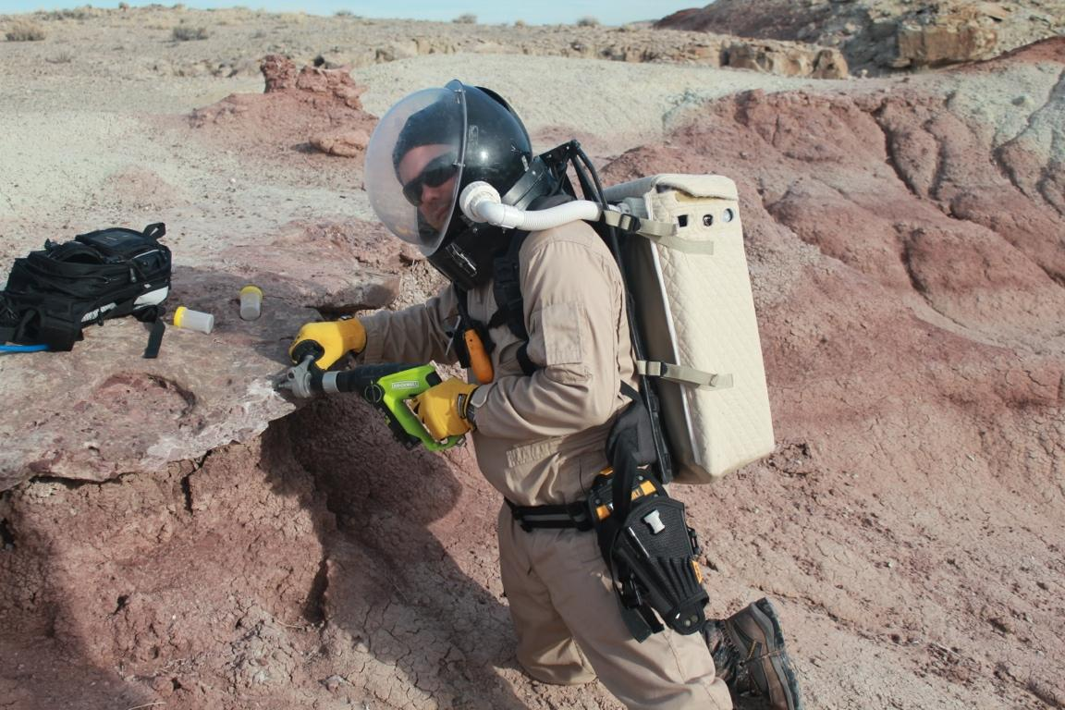
EVA SUIT LORA MESH NETWORK RELAY
Long range, low power text messages and data sets with GPS coordinates.
LORA Relay device connected via Bluetooth. (Backpack)
Android/iOS device (forearm) as terminal for text communications, GPS map

Slide 8
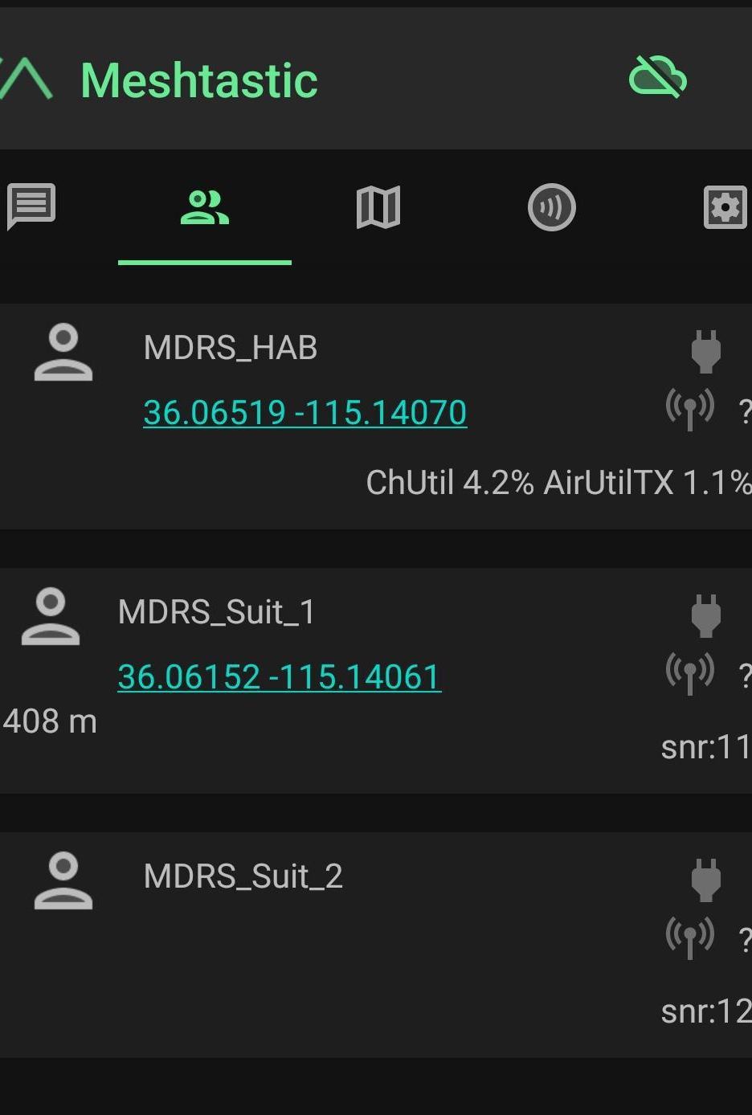
MESHTASTIC
Open-Source project using LoRa radios as long range, off-grid communicators.
Radios automatically create a mesh to forward packets, internet forwarding using MQTT
Supports up to 80 nodes

Slide 9
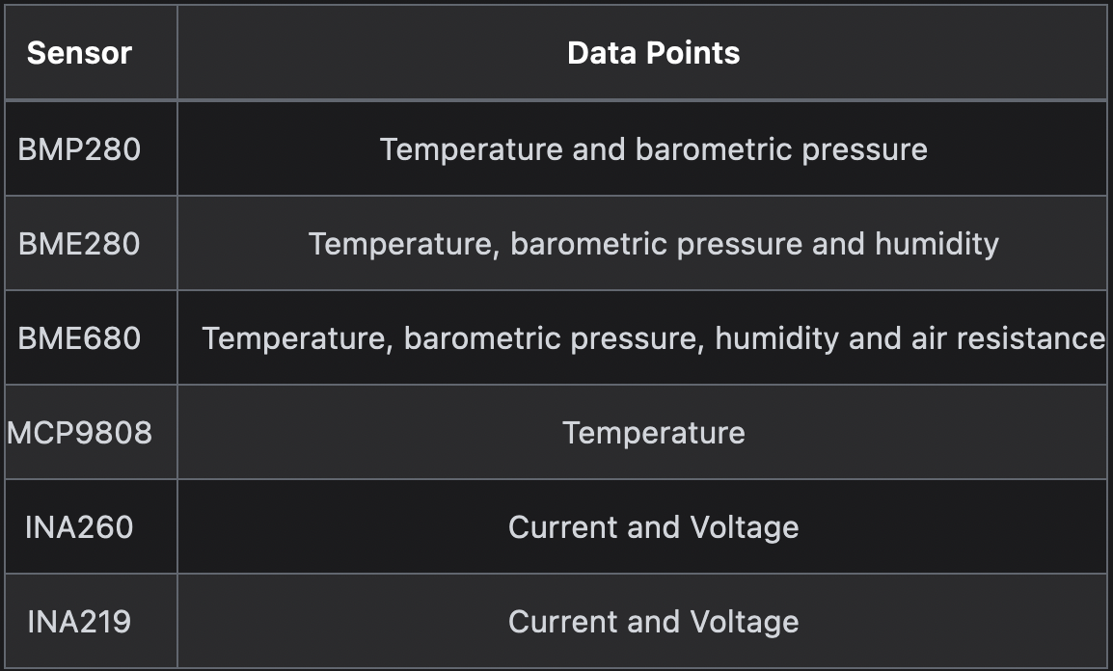
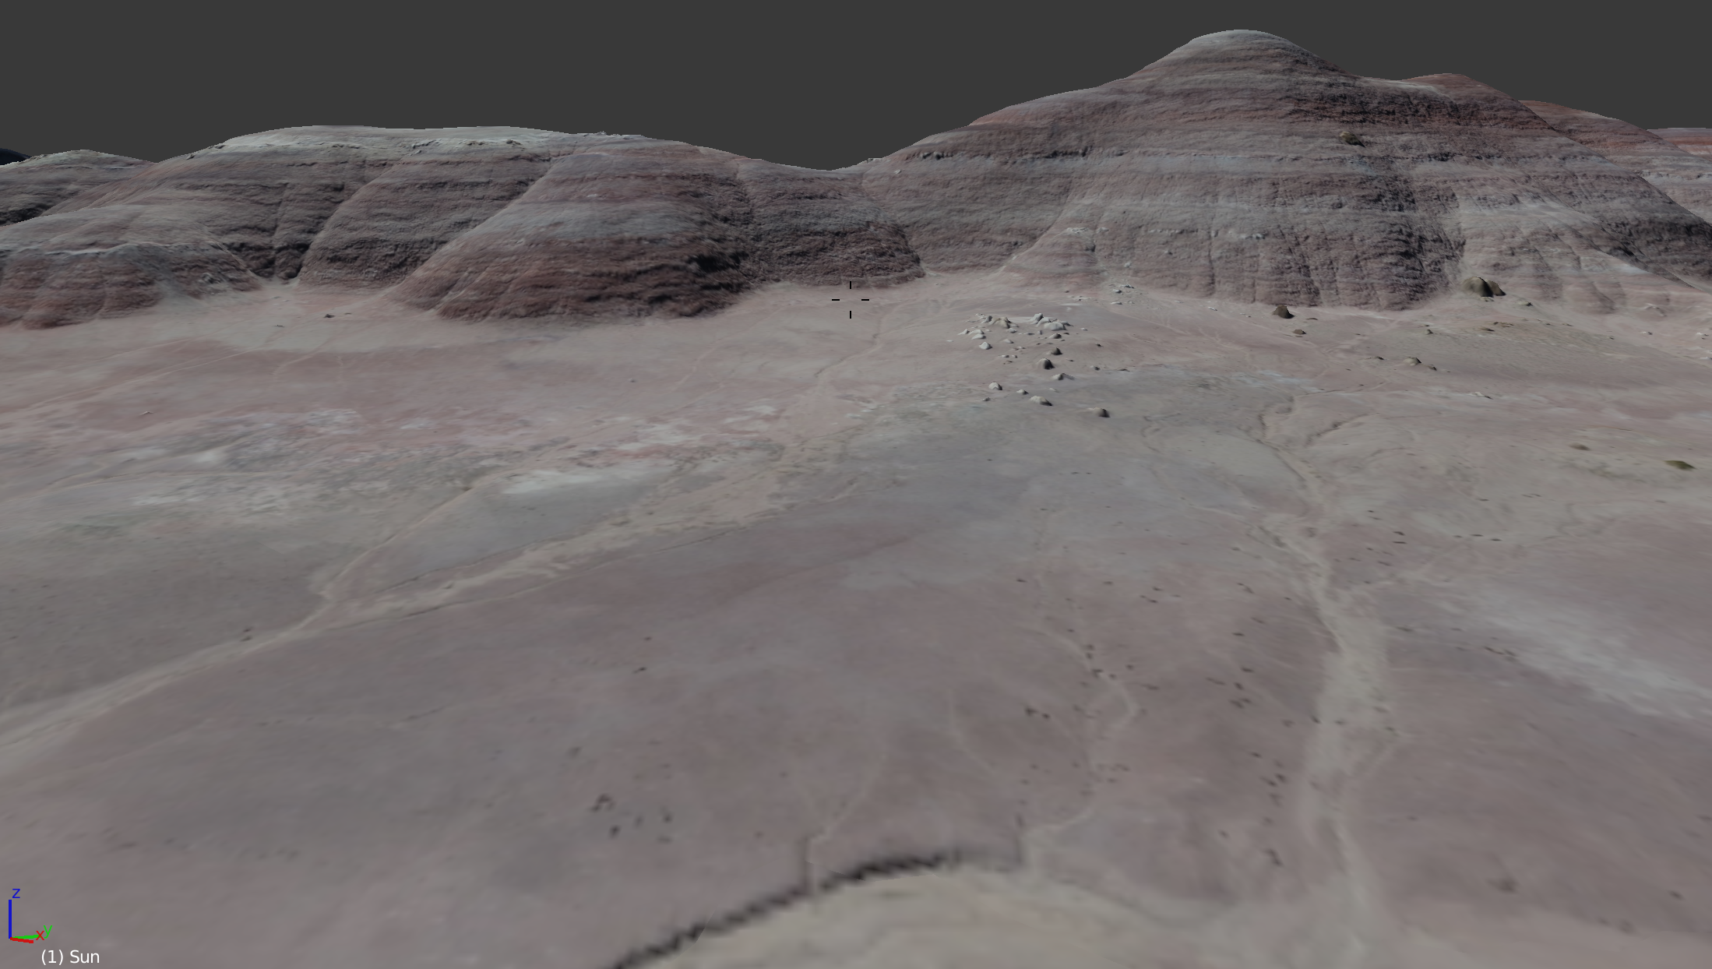
MESHTASTIC TELEMETRY USING I2C SENSORS & GPS
Relay A
MDRS 289: EVA 12
Elapsed time 2:23
EVA Vitals OK
EVA 2
Hab: ATV1 #Battery
ATV1: Battery at 35 percent.
EVA 2: Sample 23 Collected
EVA 2: Sample 24 Collected
EVA 1: Est. Return 3 hours
Hab: Lunch ready by then.
EVA 1: #Wind.
Relay 1: Winds 20 kph SSW
Hab: Winds 15 kph SW
EVA 2: We will delay drone then
EVA 1
Sample 24
Sample 23
ATV 1

Slide 10
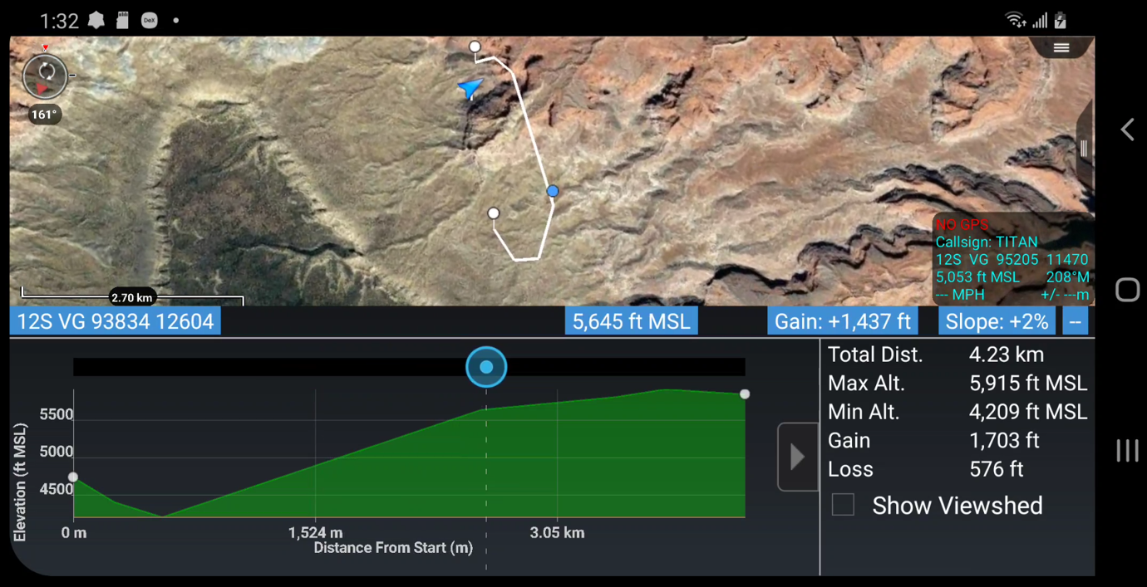
CIV-TAK
Created by Air Force Research Lab using the NASA WorldWind codebase
Android based geospatial infrastructure and situation awareness app.
Enables precision EVA planning, terrain and situational awareness, navigation, and data sharing.
Plugins provide limitless flexibility

Slide 11
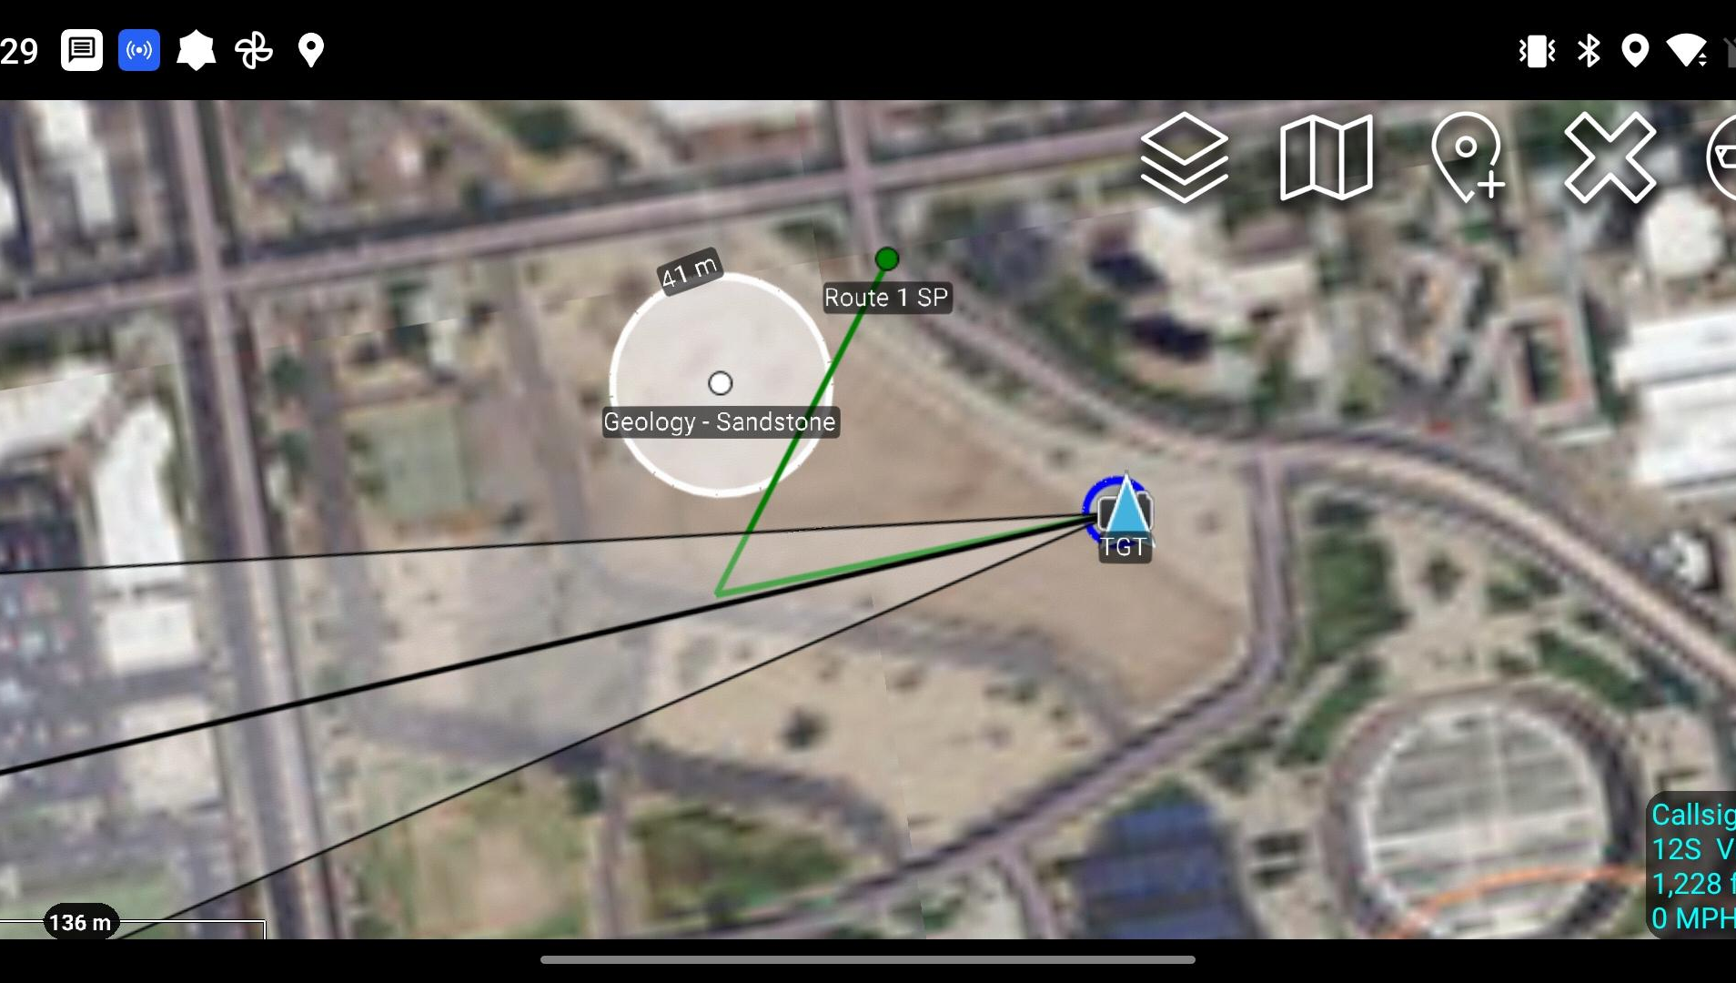

MDRS BASE STATION
Show EVA, communication in real time on 3D elevation map on a 4K monitor. Two-way texting with EVA crews at very long range.
Geotag samples in the field as collected.
Associate post-EVA lab work on those samples with the locations in this geotagged, searchable database.
Researchers can filter a map of locations for various sample collection sites (sandstone, gypsum, etc.) and plan further work. Science continuity across rotations.

Slide 12

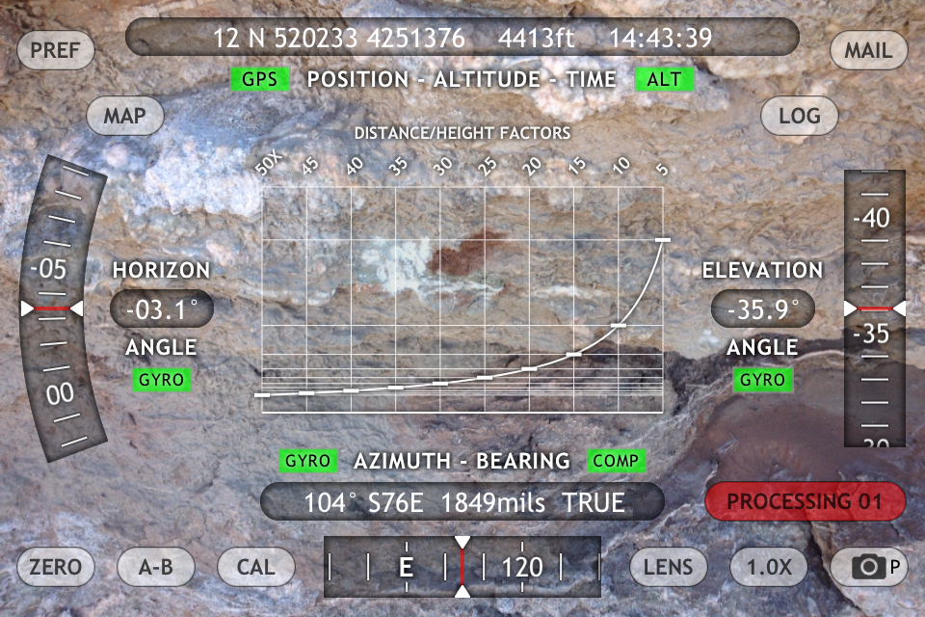
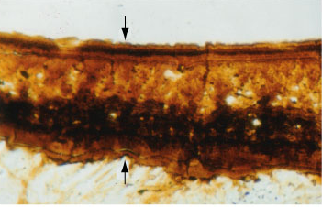
MDRS LAB NOTEBOOK
Lab notebook PC for sample analysis logging, photos, etc. (Crew 289, EVA 12, Sample 24. Generic Sample University)
On return from EVA, initial research on a given sample is logged in a central database.
Future researchers can filter on the tags and find sample sites, images, and notes from past crews.
Remote “virtual explorers” can contribute to this analysis or conduct independent studies citing this database.
This provides research continuity across teams and a great model for any field exploration system
MDRS Lab Notebook
Sample c289-e12-s24
EVA Logs
Search Notes
Research Tags: Gypsum, mudstone
Accuracy Status: Gypsum (100 %)
Researcher: J Smith (c289-Geologist)
Notes: Gypsum sample drilled to 4 cm. Will be returned to GSU for spectrographic and wet chemistry analysis.
Conclusions: Mudstone drilling requires 24v minimum battery pack. Water content 32 percent.
Images: (Link)
Update: University lab report (link)
Publication citation Links: (pending)
Status: Uploaded to cloud. Ready for citation.
Sample 24

Slide 13
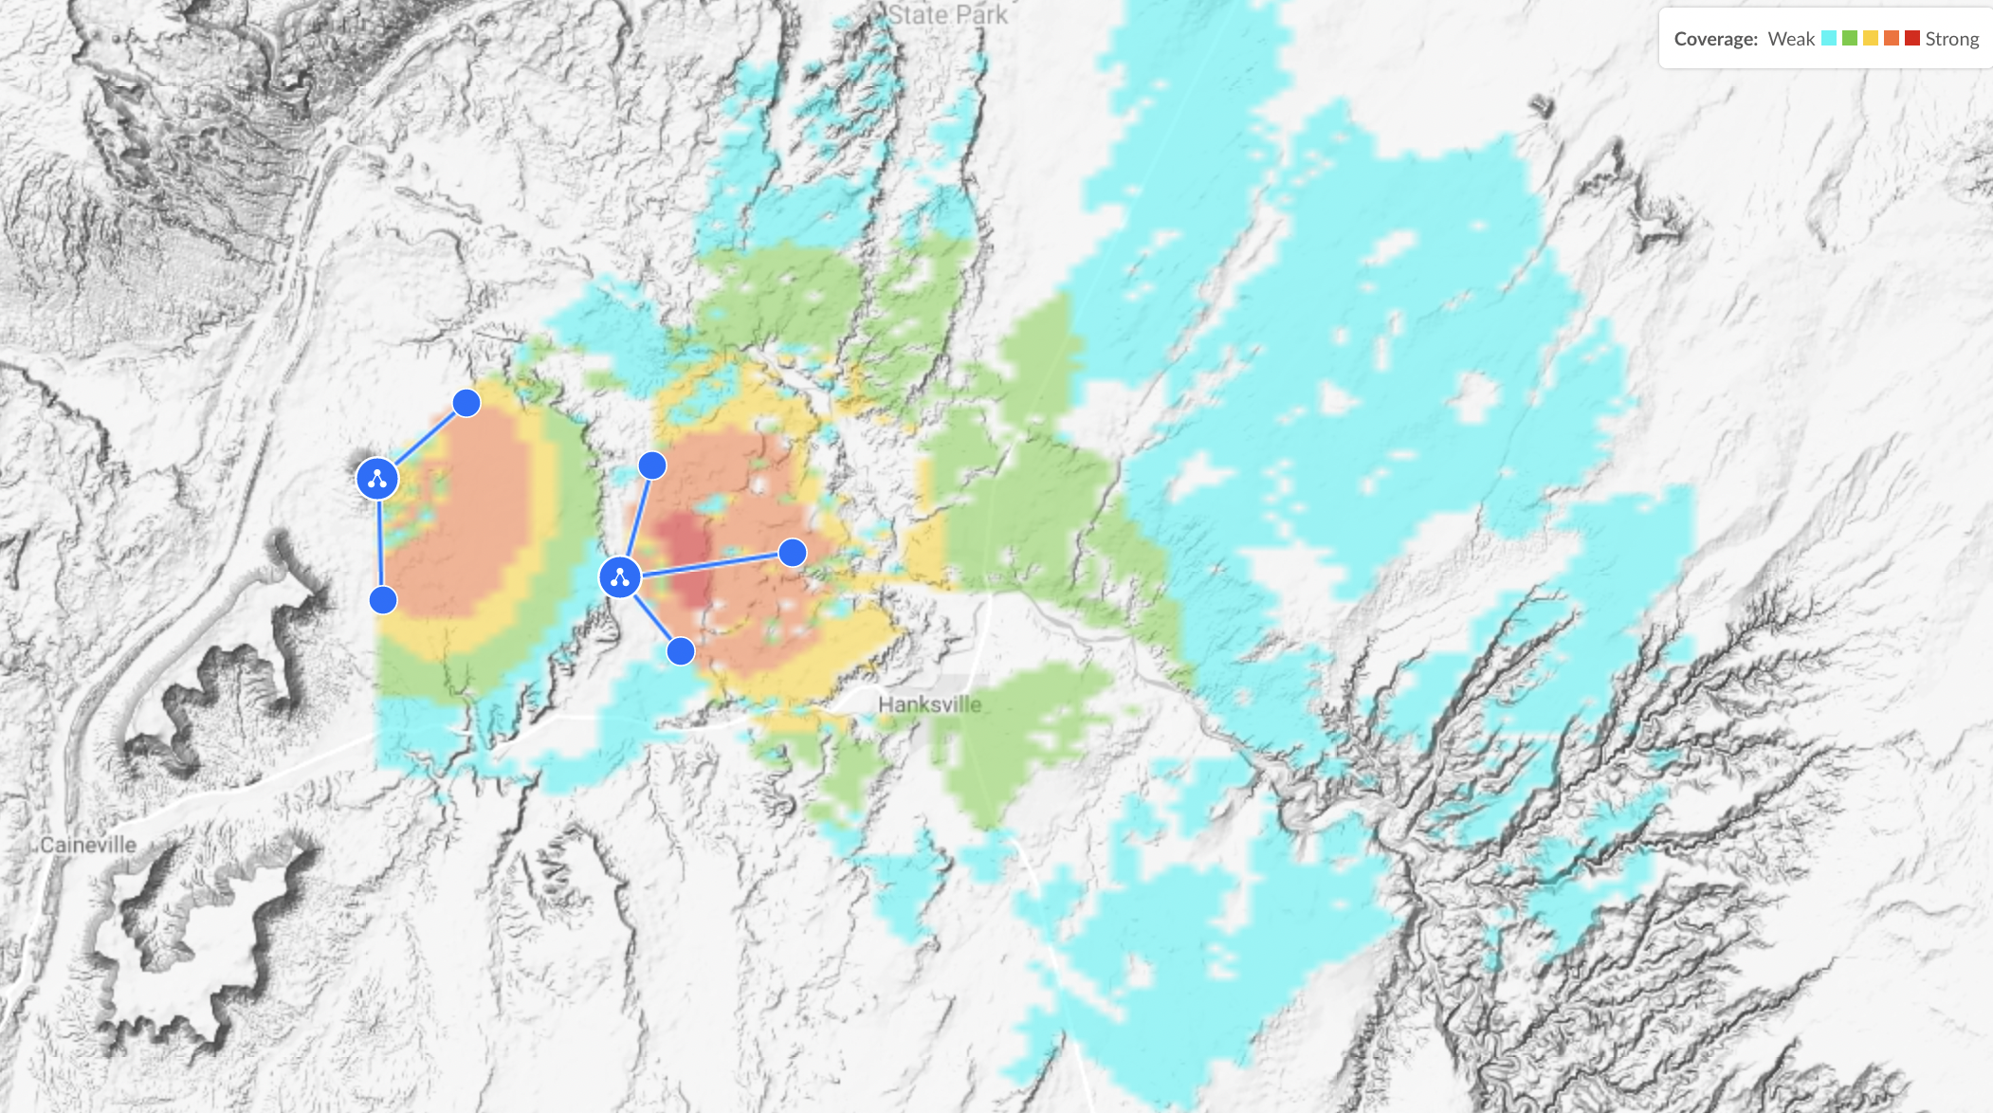
Meshnet + Voice IP
Both systems can be used simultaneously.
The LORA Meshnet system for long range EVA, samples, texts.
WiFi for voice and VR work near hab and suit to suit voice links.

Slide 14
TALENT NEEDED
Users | Tasks | Skills Needed
EVA Unit Assembly | Assembly of units Software loading units (Meshtastic) Customization of CIV-TAK client on Android phone (long term). | 3D printing Soldering Technical downloads in development environment
Hab Console Software Development | Data Stream Logging at Hab (CIV-TAK to partitioned data) Display of data on 3D GIS map | Streaming input software development GIS Visualization (Mars VR and GPS data set). User Interface and Dashboard development
Science Lab Logging System | Photo integration and lab equipment data collection CIV-TAK JSON for equipment telemetry | CMS development experience Database and visualization (Geocodes, GeoJSON) User Interface and Dashboard development Lab equipment integration development
Long Term | Remote science equipment integration Bot queries (weather, power, etc.)

Slide 15




JOIN US!
Find the Chicago Chapter on Facebook
eric.kristoff@gmail.com
knebergall@gmail.com
jason.d.simpson@gmail.com
https://www.facebook.com/groups/marssocietychicago

Slide 16
DATABASE STRUCTURE
Mission Database
ID
Objectives
Logs
EVA Plans
Objectives
Waypoints
Workflow Status
Member EVA Logs
GPS Trace/times
Journal (website)
File Attachments
Geotagged samples, texts, and photos
Crew Members
Name
Role
CV, etc.
Sample Analysis
Field Data
Lab Data
Publication Notes
Analysis Results
Collection of lab data, samples, and so on by sample type, details.
Map Data Set
Terrain Maps
GeoJSON Logs
GeoJSON Records
Equipment
Name
Category (ATV/etc.)
Start Date
Current Location
Maintenance Plans
Equipment Link
Fix Planned
Procedure
Results
Professional Publications
Maintenance JSON
(Items, repairs, and time stamps for analysis)
Maintenance Dashboards

Slide 17
PRIMARY GOALS (BASELINE SYSTEM)
Users | Features | Benefits
EVA Crew (Field) | GPS tracking of suits, ATVs, and supported equipment relayed to Hab periodically. Text messages between Hab and crew members in a secure network | Distress call tracking (Safety) Sample Position tracking and other data point recording (Science) Immersion in EVA/Mars experience (Sim) Log EVA paths and compare planned/actual paths Identify interesting locations for revisit/research
Hab Crew | Long-range text communications with EVA crews EVA tracking with a geotagged database of reports and sample analysis | Prompt response in emergencies or important message links. More immersion and experience in a situation far closer to actual Mars EVA, with hab-based support
Science | Crews can log sample analysis work along with locations in permanent MDRS database | Future crews can scan database for sample locations and analysis results relevant to research Mars VR “Crowdsploring” but with sample data libraries

Slide 18
Phase | Project Elements | Capacities
Base System | Mesh network using off the shelf, open source software and smartphone links. GIS system for logging routes, samples, and crew messaging Lab notebook for reporting samples upon return to MDRS Science Dome. | Communicate and track EVA across 5-15 km Promotes safety, simulation immersion and science dramatically. Gives continuity logs across crews and filtered research on topics.
Full System | Add a secondary digital voice system, improved logging, and solar-powered hilltop relays. | Secondary digital voice system across medium range.
Open API | Give a common API for interfacing field gear with the system, allowing motion studies, free-standing weather stations, photo tagging, smart-suit add-ons, and other capabilities. Allow data mining of the research database. | Allows future crews, volunteers and university teams to expand the sensor and science network. Add AI analysis, crowd-exploration, and other democratization efforts
2.0 System | Suit temperature/movement data, follow-me drones, voice transcription and SMS to remote researchers. | Everything NASA MDRS crews were doing in 2004 using four moving trucks of equipment.

Slide 19
MDRS BASE STATION
Hab 4K TV with fanless PC and Lora relay
Displays EVA progress and network chatter between EVA, Hab, and remote instruments. These would be time stamped and logged.
Show EVA, communication in real time on 3D elevation map on a 4K monitor. Two-way texting with EVA crews at very long range.
Geotag samples in the field as collected.
Associate post-EVA lab work on those samples with the locations in this geotagged, searchable database.
Researchers can filter a map of locations for various sample collection sites (desert varnish, gypsum, etc.) and plan further work. Science continuity across rotations.
Relay A
MDRS 289: EVA 12
Elapsed time 2:23
EVA Vitals OK
EVA 2
Hab: ATV1 #Battery
ATV1: Battery at 35 percent.
EVA 2: Sample 23 Collected
EVA 2: Sample 24 Collected
EVA 1: Est. Return 3 hours
Hab: Lunch ready by then.
EVA 1: #Wind.
Relay 1: Winds 20 kph SSW
Hab: Winds 15 kph SW
EVA 2: We will delay drone then
EVA 1
Sample 24
Sample 23
ATV 1

Slide 20
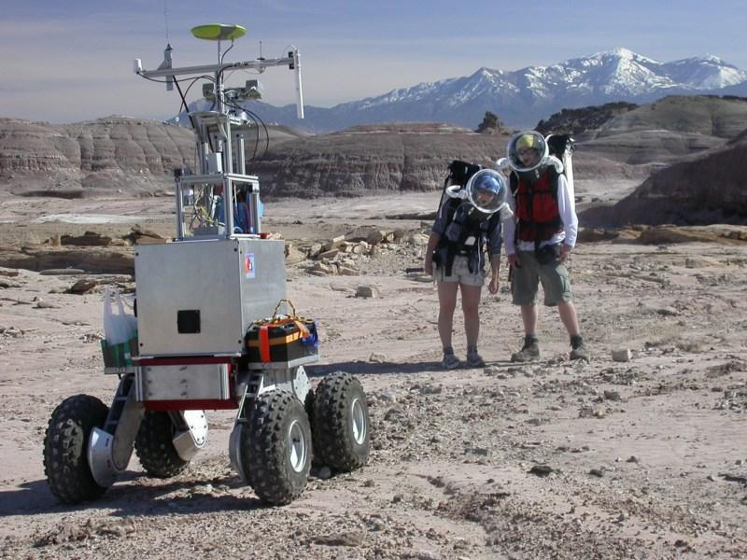
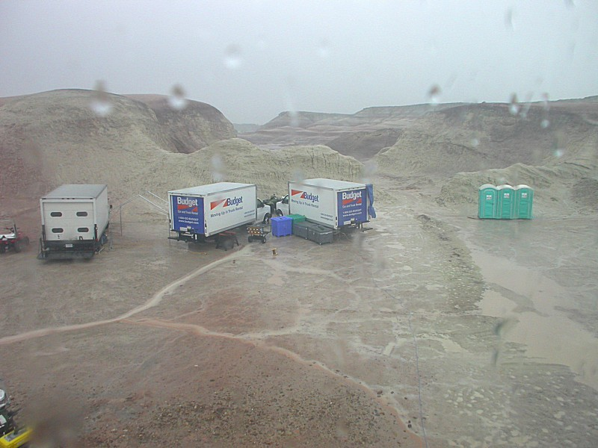
NASA AT MDRS 2006
Satellite Navigation
Digital Panorama Pictures
Digital Relay
Voice Recognition
Follow Me AI/Autonomy
Network over entire area
Three box trucks of equipment
Digital Voice Comms
Tag sample data (GIS)
Email info from field to SMEs directly
Notes:
Does this fit in?

Slide 21
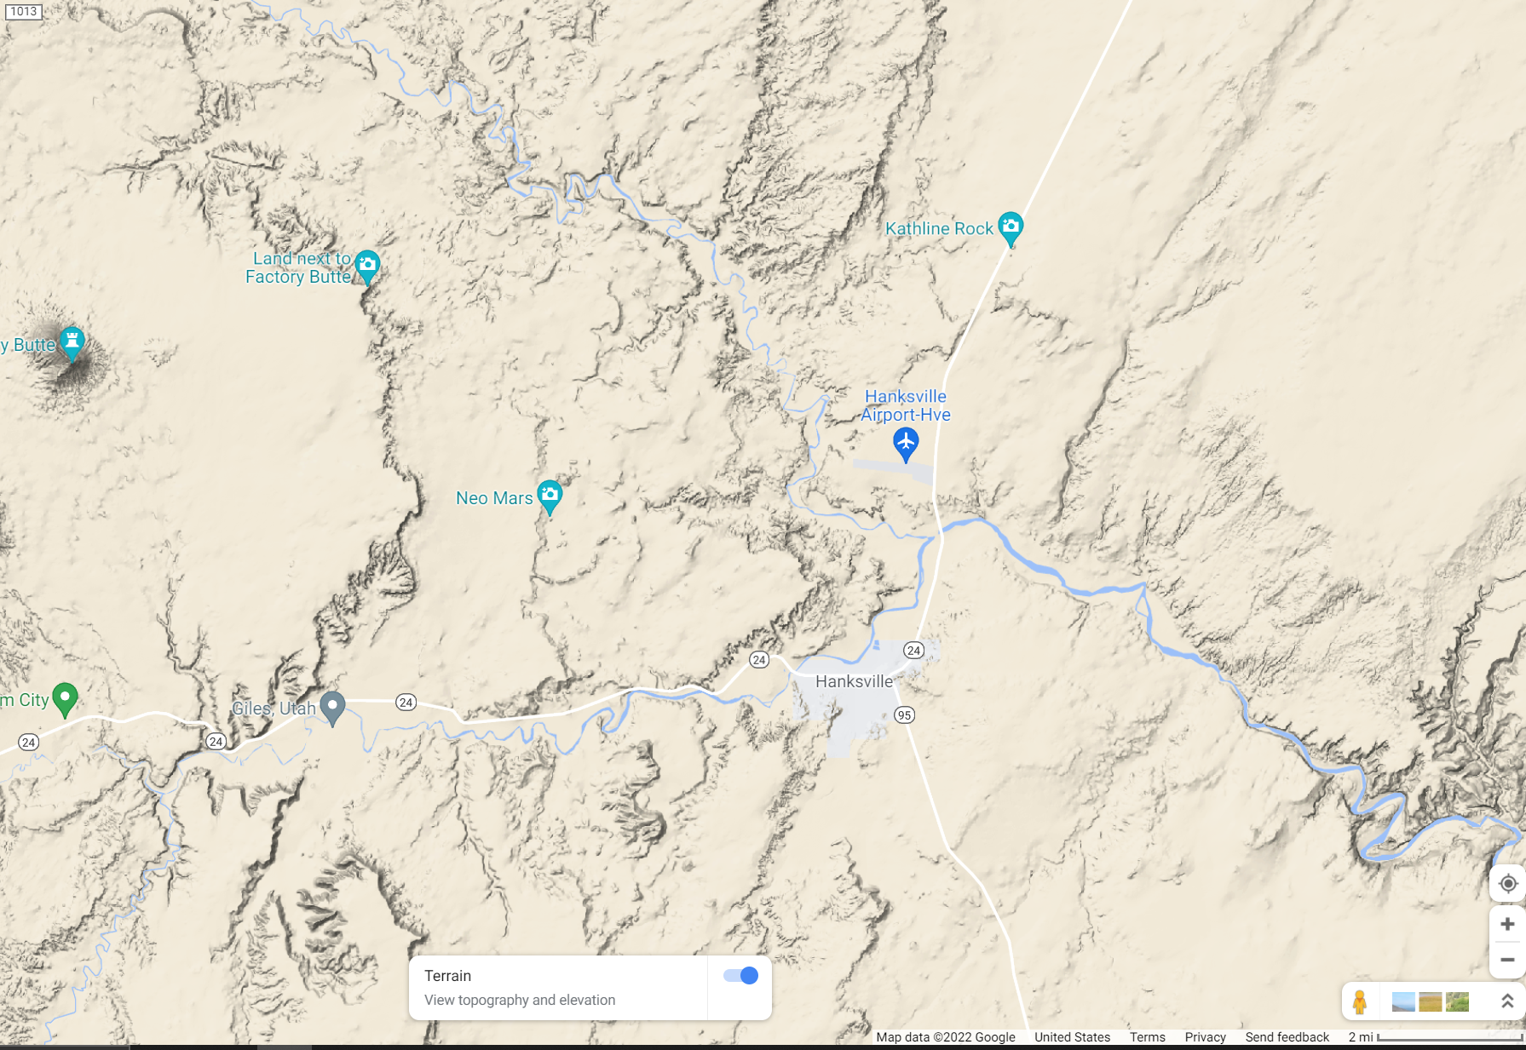
Meshnet + Voice IP
Both systems can be used simultaneously.
The LORA Meshnet system for long range EVA, samples, texts.
WiFi for voice and VR work near hab and suit to suit voice links.

Slide 22
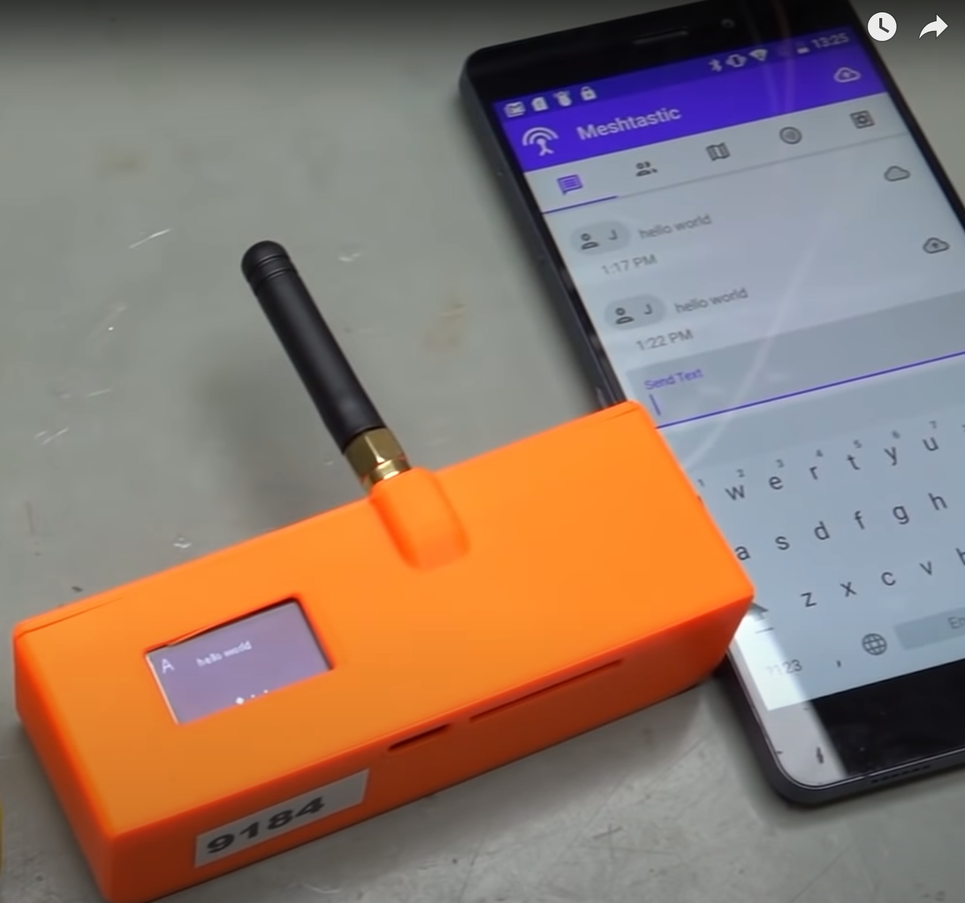
EVA SUIT LORA MESH NETWORK RELAY
Long range, low power text messages and data sets with GPS coordinates.
LORA Relay device connected via Bluetooth. (Backpack)
Android/iOS device (forearm) as terminal for text communications, GPS map

Slide 23
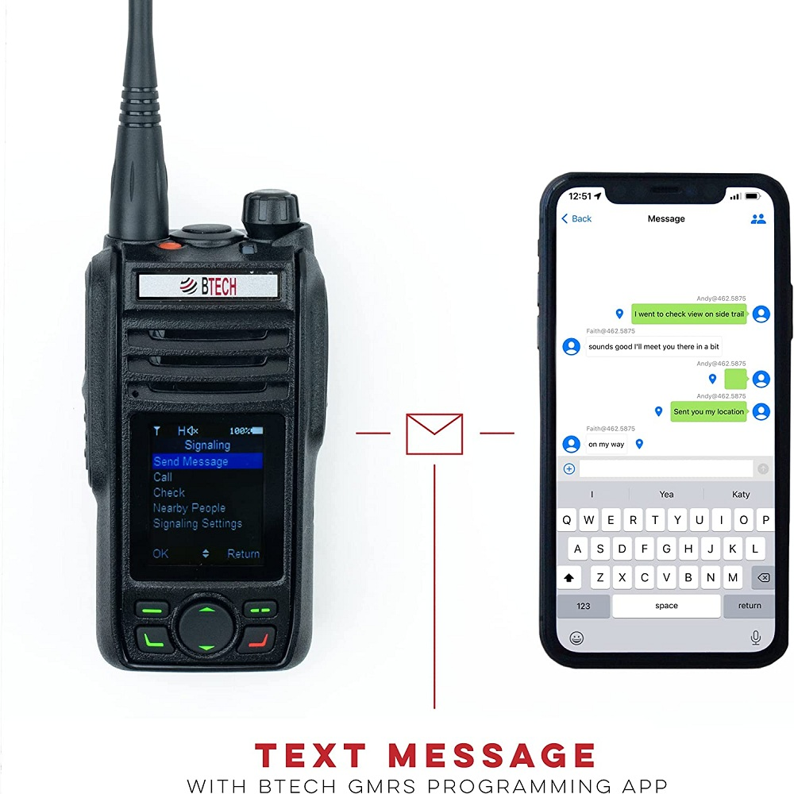
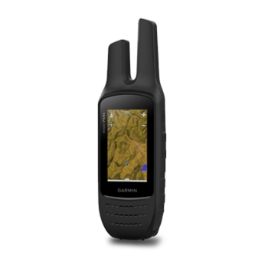
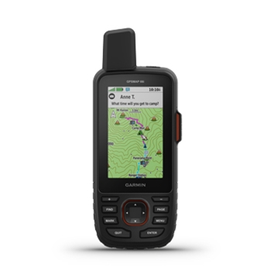
HIGH BANDWIDTH OPTIONS
BTECH GMRS-Pro ($140) | 5-Watt GMRS Voice/Data Radio. Weather alerts. Send GPS locations from connected Cell phone, texts. Can configure as repeater Requires HAM Radio License
Garmin Rino 755T ($580) | All in one unit (compass, barometer, GPS) 3-inch touchscreen with Typo maps 5-Watt GMRS radio – 20-mile LOS range 8 MP camera built-in with GPS geotagging Bluetooth Headset Smartphone connection (text messages, weather) Weather downloads via Wi-Fi Requires HAM Radio License
Garmin 66i ($600+ $65/mo.) | Satellite Link for Text messages, SOS Geolocation. Works anywhere in the world (Iridium) Map (satellite download via Wi-Fi) No voice option. Will connect to cell phone. Subscription is expensive, but no license required
Notes:
BTECH GMRS-PRO 5W GPS, Bluetooth, App Programmable GMRS Mobile Radio - BaoFeng Radios (baofengtech.com)

